Slide 1
ELL225
Quarter Car Suspension Model
ABHINAV REDDY ORUGANTI
2019EE10455

Slide 2
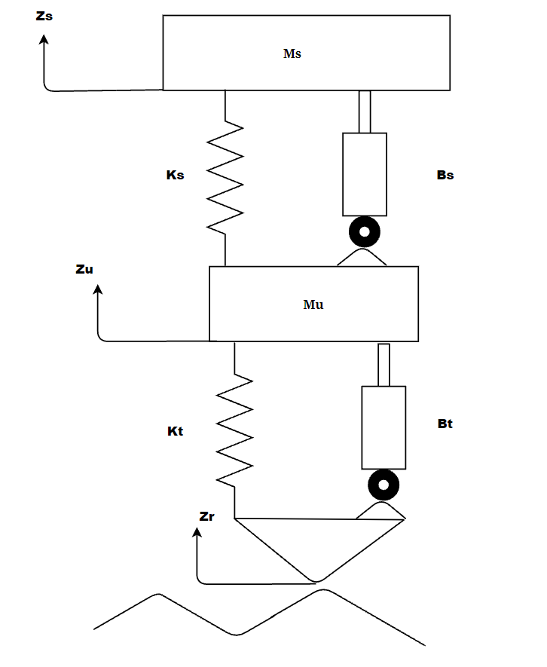

Slide 3
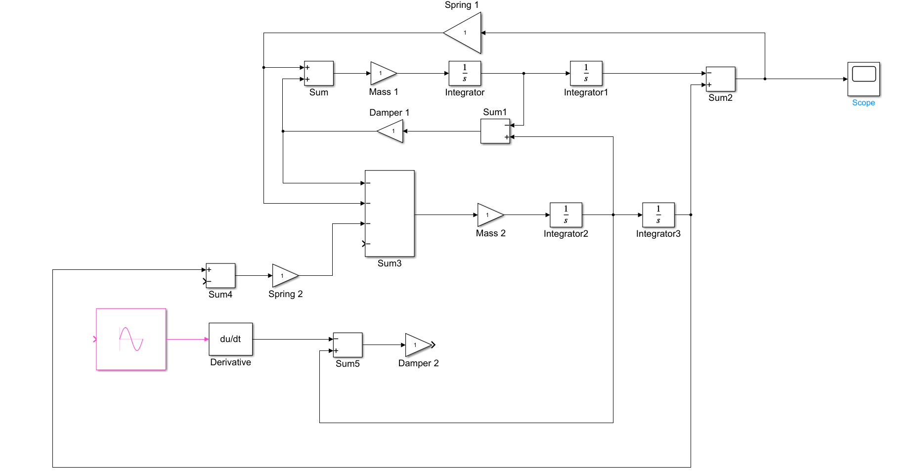

Slide 4
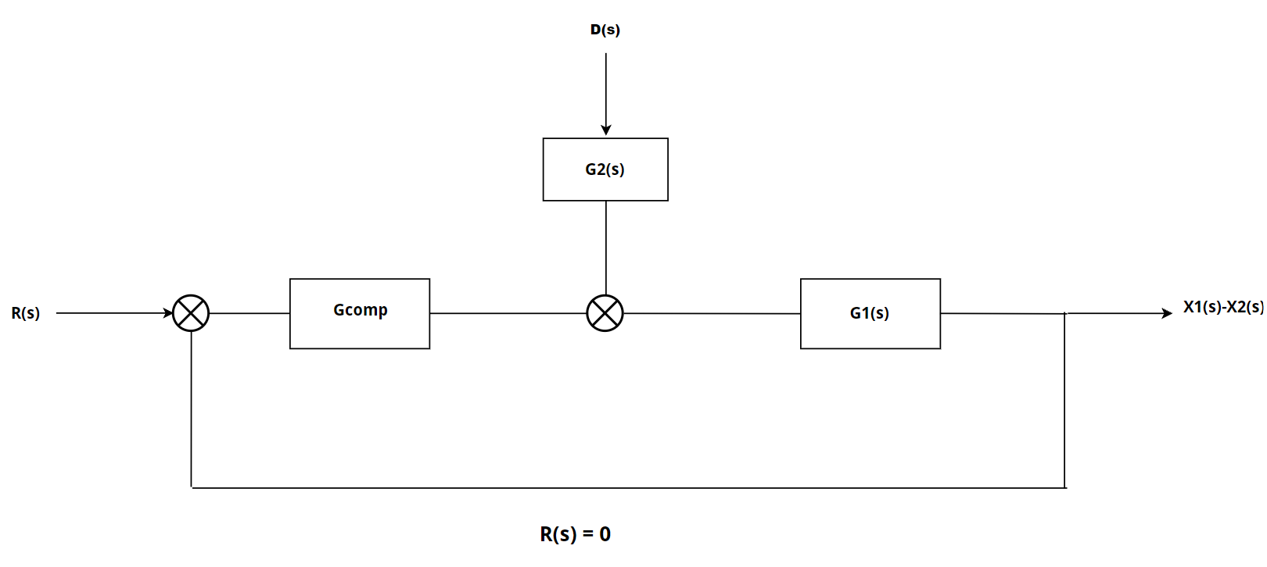


Slide 5
